Slide 1
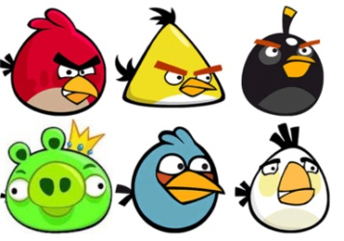
Come and play ng bingo with the
Angry Birds!
How many ng words can you read?

Slide 2
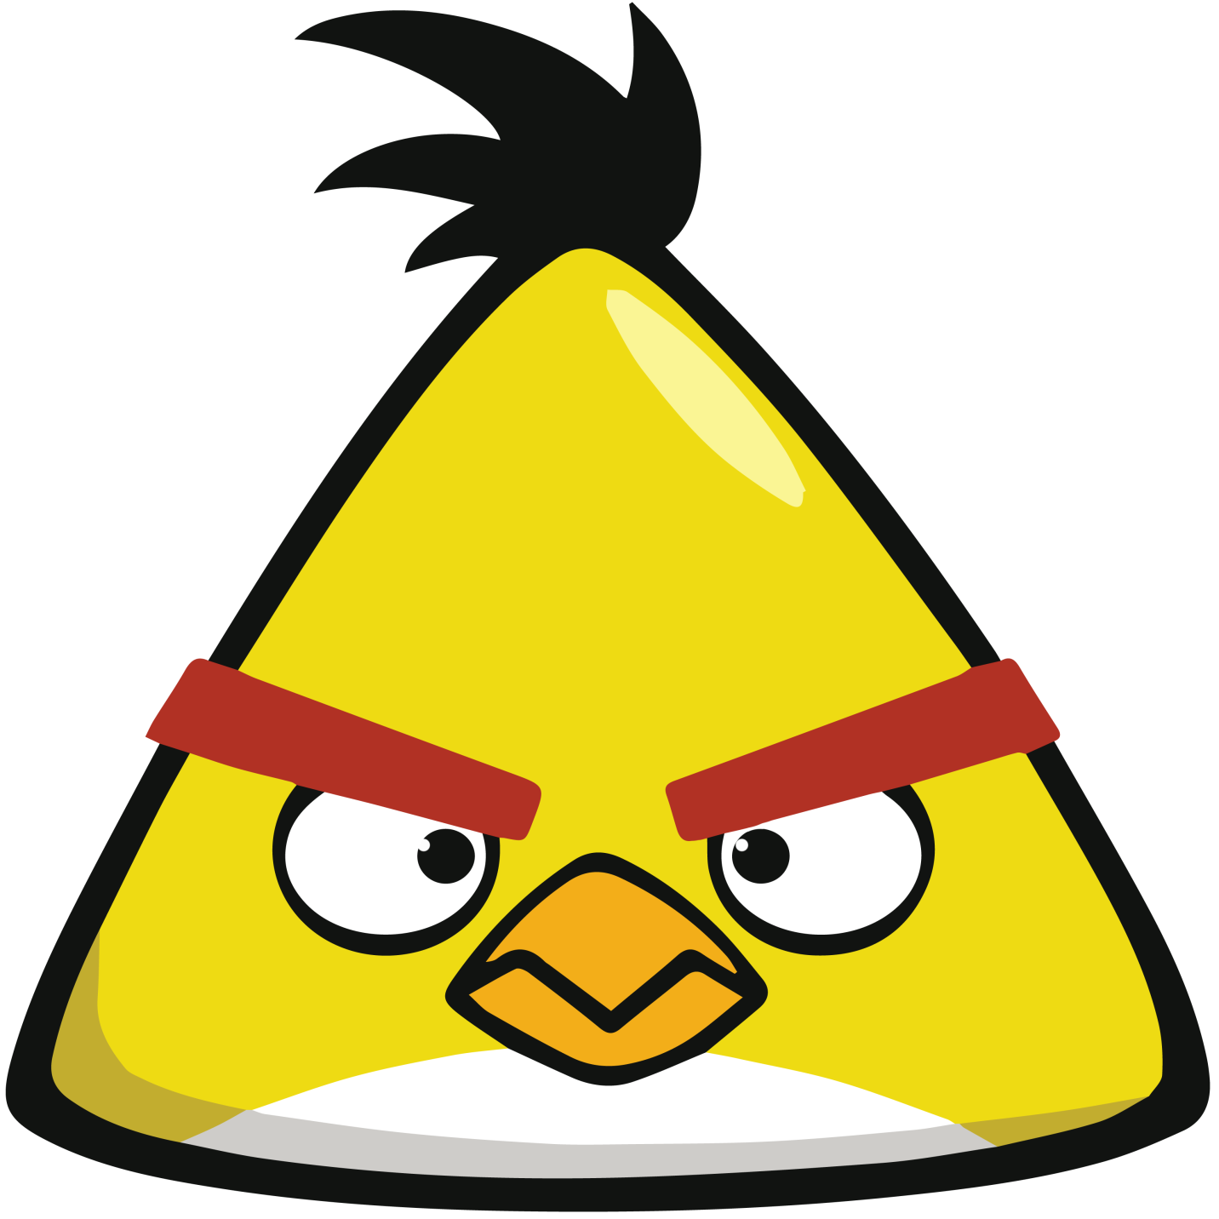

Slide 3


Slide 4


Slide 5
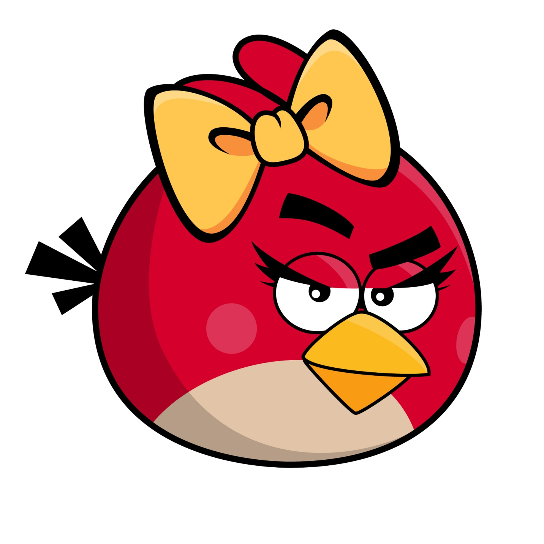

Slide 6
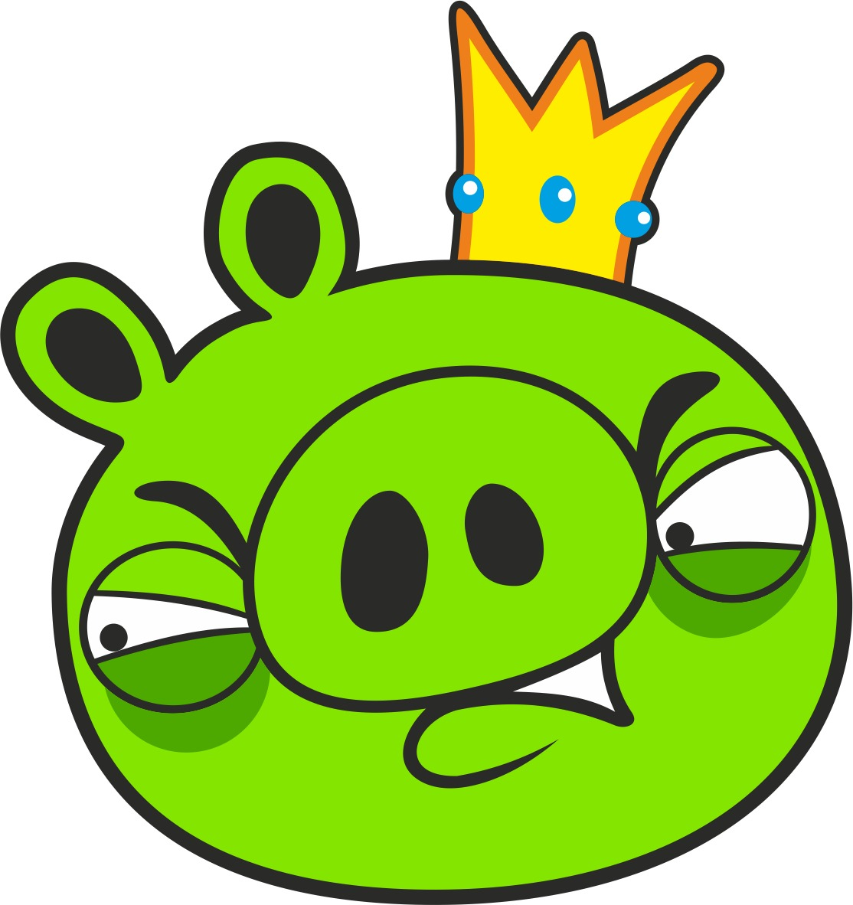

Slide 7


Slide 8
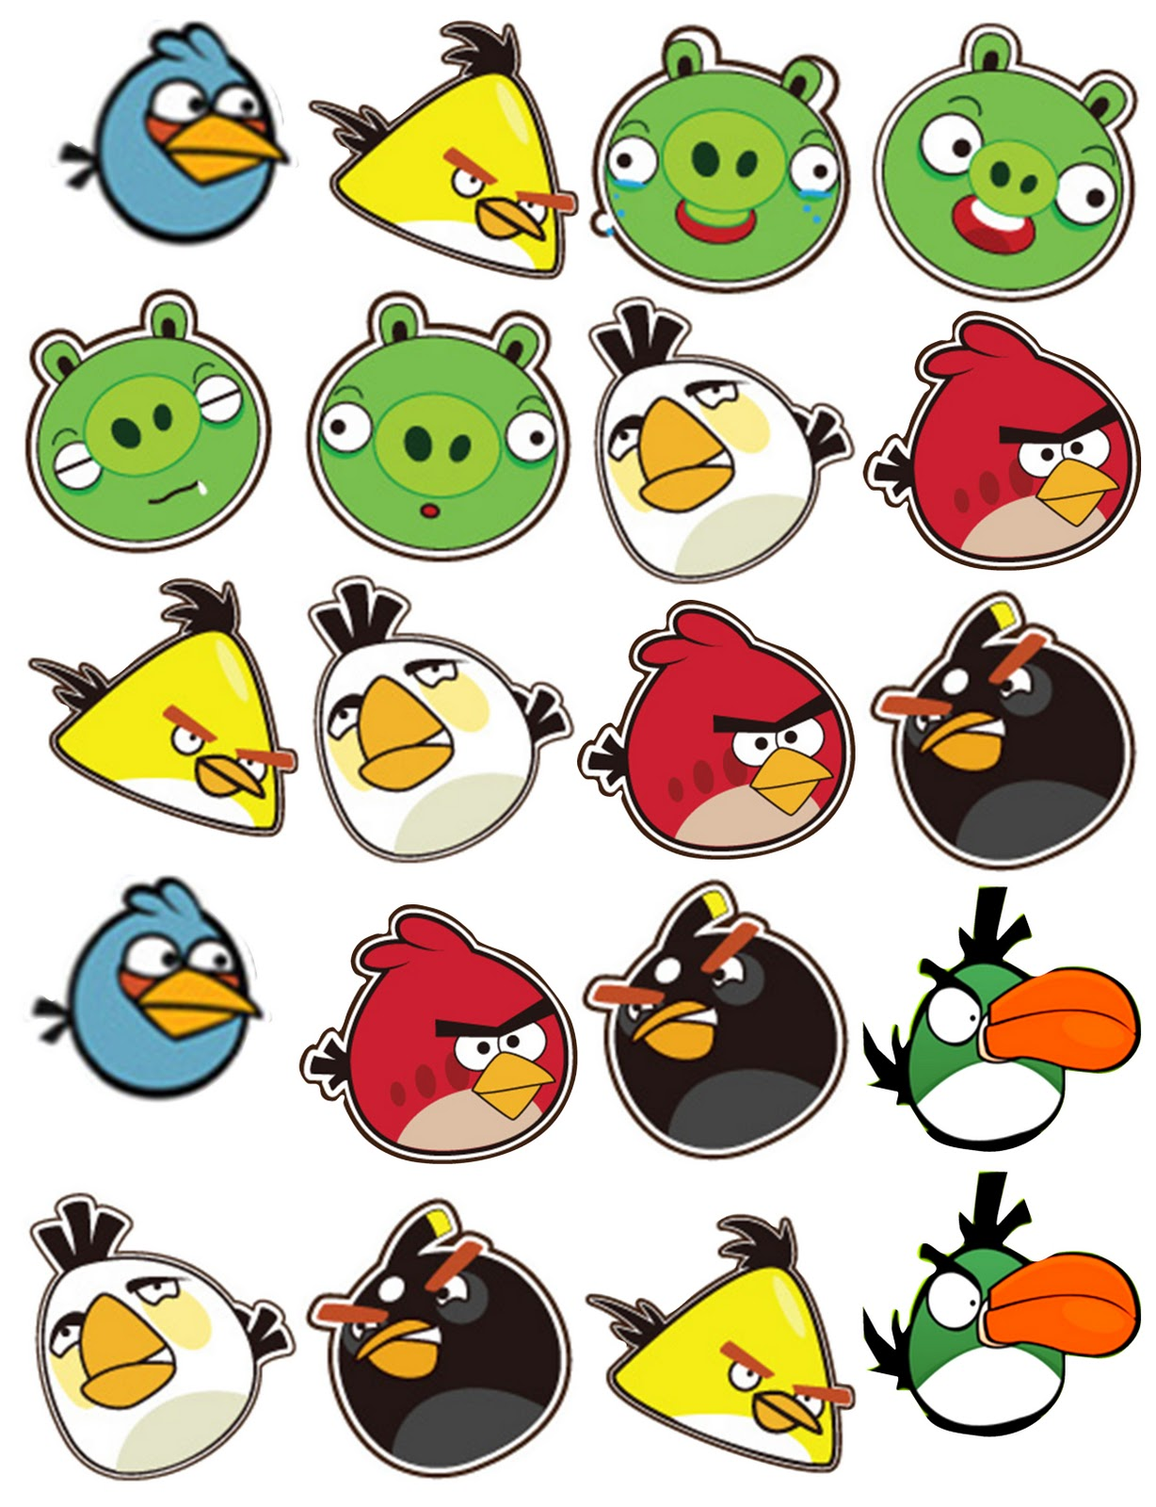
ng

Slide 9
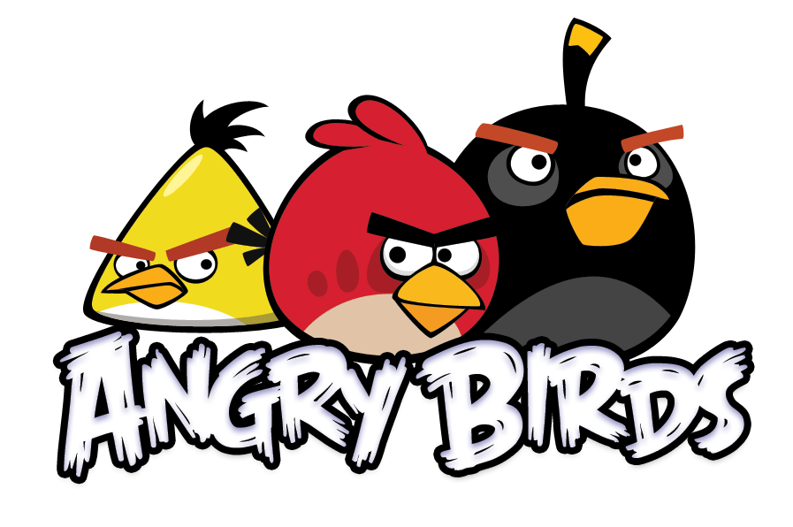



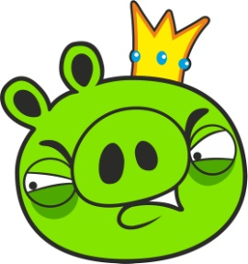
lung | sting
song | wing

Slide 10
zing | bring
sprung | swing

Slide 11
strong | king
fang | wing

Slide 12
ding | pong
bong | string

Slide 13
ping | long
gang | dong

Slide 14
sing | tang
rung | hung

Slide 15
sang | thing
angry | spring

